Slide 1

BACHELOR OF BUSINESS ADMINISTRATION BBA - 3rd Semester COMPUTER APPLICATION – I : BBA306
Manish
Assistant Professor
Faculty of CS & IT
Kalinga University
Naya Raipur (C.G.), India

Slide 2

COURSE OBJECTIVES
To familiarize with Front-end concept for developing various IT Applications Project.

Slide 3
COURSE OUTCOMES
The successful completion of this course shall enable the student:
CO1: To understand the GUI and Windows Programming.
CO2: To understand about the Concepts in Visual Basic.
CO3: To understand about the programming in visual basic.
CO4: To understand creating and application of problems.

Slide 4
CONTENTS
BACHELOR OF BUSINESS ADMINISTRATION
Semester- 3rd
Paper Code – BBA306
Subject Name-COMPUTER APPLICATION – I
S.No. | Unit Name /Topic
1 | Concept & Tools, The Title Bar
2 | Menu System, Menus and The Menu Bar
3 | The Size Box, System Menu Box, Icons
4 | Cursors, Scroll Bars, Tool Bar, Client Area.
5 | Introduction to Visual Basic Environment: features of Visual Basic
6 | Starting Visual Basic the Environment,
7 | The Special Features of the Menu Bar Customizing the Visual Basic Environment

Slide 5
Content (Unit – I)
Introduction to GUI and Windows Programming: GUI: Concept & Tools, The Title Bar, Menu System, Menus and The Menu Bar, The Size Box, System Menu Box, Icons, Cursors, Scroll Bars, Tool Bar, Client Area. Introduction to Visual Basic Environment: features of Visual Basic, Starting Visual Basic the Environment, The Special Features of the Menu Bar Customizing the Visual Basic Environment.
BBA306 computer Application

Slide 6
Text & Reference Books :
Text Book:
Foxall James, 2008, Visual Basic in 24 hrs/ SAMS Teach Yourself in 24 hrs, 1st Edition, Pearson Education.
Teach yourself Visual Basic, 2004, Tech media Publication.
Reference Books:
Black Book of Visual Basic, 2008, Dream Tech Press.
Beginning in Visual Basic 6.0, 2008, Wrox Publication.

Slide 7
LECTURE PLAN
Lecture No. | Topics to be covered | Slide No.
L-1 | Concept & Tools, The Title Bar | 9-10
L-2 | Menu System, Menus and The Menu Bar | 11-13
L-3 | The Size Box, System Menu Box, Icons | 14-15
L-4 | Cursors, Scroll Bars, Tool Bar, Client Area. | 16-17
L-5 | Introduction to Visual Basic Environment: features of Visual Basic | 18-24
L-6 | Starting Visual Basic the Environment, | 25-28
L-7 -8 | The Special Features of the Menu Bar Customizing the Visual Basic Environment | 29-30

Slide 8
Unit – I

Slide 9
Concept & Tools
GUI is an interface that allows users to interact with different electronic devices using icons and other visual indicators. The graphical user interfaces were created because command line interfaces were quite complicated and it was difficult to learn all the commands in it.
In today’s times, graphical user interfaces are used in many devices such as mobiles, MP3 players, gaming devices, smart phones etc.

Slide 10
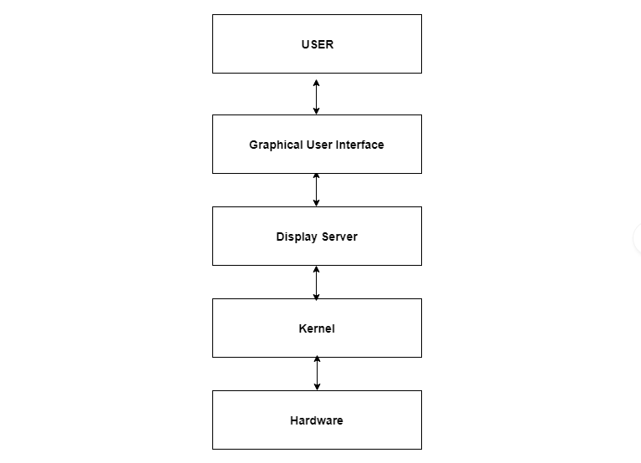
The below diagram provides the position of the graphical user interface with respect to the computer system

Slide 11
Menu System
One of the most important parts of your Desktop is the Taskbar. By default, it sits at the bottom of your screen giving you access to the Start Menu, several application icons, and the Notification Area.

Slide 12
Graphical User Interface makes use of visual elements mostly. These elements define the appearance of the GUI.
Some of these are described in detail as follows −

Slide 13
Menus & Menu Bar
One of the most significant changes in Visual Basic 6.0 is the Integrated Development Environment (IDE). IDE is a term commonly used in the programming world to describe the interface and environment that we use to create our applications. It is called integrated because we can access virtually all of the development tools that we need from one screen called an interface. The IDE is also commonly referred to as the design environment, or the program.
The Visual Basic IDE is made up of a number of components
Menu Bar
Tool Bar
Project Explorer
Properties window
Form Layout Window
Toolbox
Form Designer

Slide 14
System Menu Bar:
This Menu Bar displays the commands that are required to build an application. The main menu items have sub menu items that can be chosen when needed. The toolbars in the menu bar provide quick access to the commonly used commands and a button in the toolbar is clicked once to carry out the action represented by it.
Toolbar:
The Toolbox contains a set of controls that are used to place on a Form at design time thereby creating the user interface area. Additional controls can be included in the toolbox by using the Components menu item on the Project menu. A Toolbox is represented in figure 2 shown below.

Slide 15
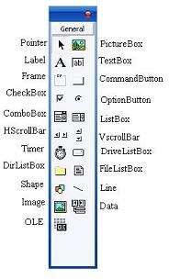
Figure: Toolbox window with its controls available commonly.

Slide 16
Client Area
This is the element that displays the information on the screen. It is very easy to manipulate a window. It can be opened or closed with the click of an icon. Moreover, it can be moved to any area by dragging it around. In a multitasking environment, multiple windows can be open at the same time, all of them performing different tasks.
There are multiple types of windows in a graphical user interface, such as container window, browser window, text terminal window, child window, message window etc.

Slide 17
Icons
Files, programs, web pages etc. can be represented using a small picture in a graphical user interface. This picture is known as an icon. Using an icon is a fast way to open documents, run programs etc. because clicking on them yields instant access.

Slide 18
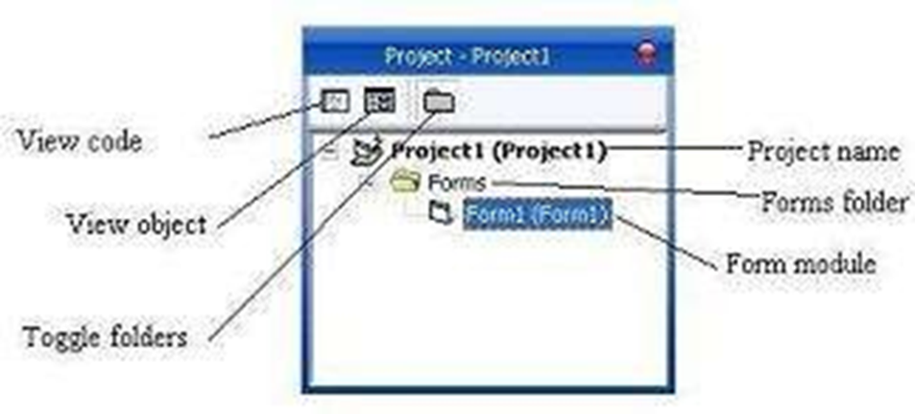
Introduction to Visual Basic
Docked on the right side of the screen, just under the tollbar, is the Project Explorer window. The Project Explorer as shown in in figure serves as a quick reference to the various elements of a project namely form, classes and modules. All of the object that make up the application are packed in a project. A simple project will typically contain one form, which is a window that is designed as part of a program's interface. It is possible to develop any number of forms for use in a program, although a program may consist of a single form. In addition to forms, the Project Explorer window also lists code modules and classes.
Figure: Project Explorer

Slide 19
Visual Basic
Visual Basic is a tool that allows you to develop Windows (Graphic User Interface - GUI) applications. The applications have a familiar appearance to the user.
Visual Basic is event-driven, meaning code remains idle until called upon to respond to some event (button pressing, menu selection, ...). Visual Basic is governed by an event processor. Nothing happens until an event is detected.
Once an event is detected, the code corresponding to that event (event procedure) is executed. Program control is then returned to the event processor.

Slide 20
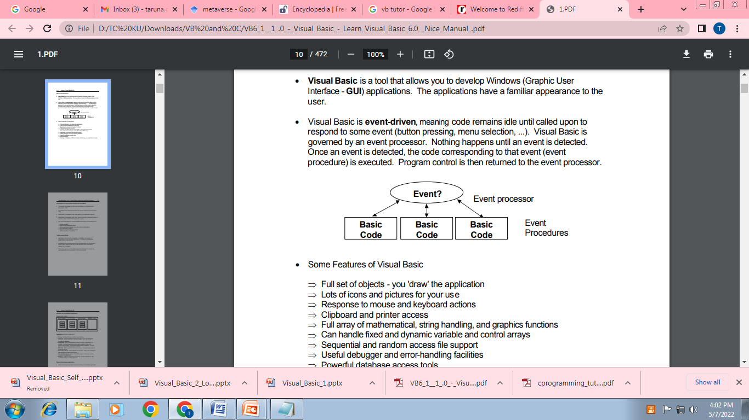
Event Processor

Slide 21
Some Features of Visual Basic
Full set of objects - you 'draw' the application
Lots of icons and pictures for your use
Response to mouse and keyboard actions
Clipboard and printer access
Full array of mathematical, string handling, and graphics functions
Can handle fixed and dynamic variable and control arrays
Sequential and random access file support
Useful debugger and error-handling facilities
Powerful database access tools
ActiveX support
Package & Deployment Wizard makes distributing your applications simple

Slide 22
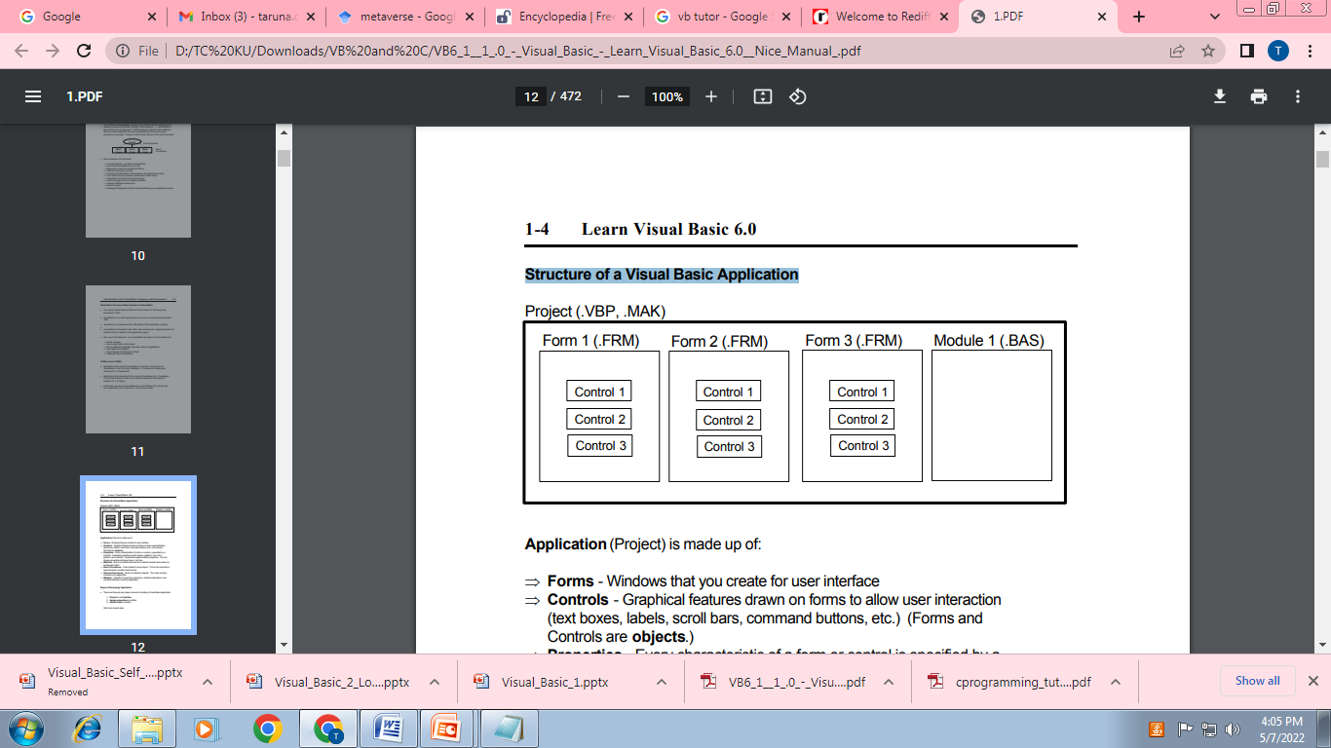
Structure of a Visual Basic Application

Slide 23
Application (Project) is made up of:
Forms - Windows that you create for user interface
Controls - Graphical features drawn on forms to allow user interaction (text boxes, labels, scroll bars, command buttons, etc.) (Forms and Controls are objects.)
Properties - Every characteristic of a form or control is specified by a property. Example properties include names, captions, size, color, position, and contents. Visual Basic applies default properties. You can change properties at design time or run time.

Slide 24
Application (Project) is made up of:
Methods - Built-in procedure that can be invoked to impart some action to a particular object.
Event Procedures - Code related to some object. This is the code that is executed when a certain event occurs.
General Procedures - Code not related to objects. This code must be invoked by the application.
Modules - Collection of general procedures, variable declarations, and constant definitions used by application.

Slide 25
Starting Visual Basic
There are three primary steps involved in building a Visual Basic application:
1. Draw the user interface
2. Assign properties to controls
3. Attach code to controls

Slide 26
Starting Visual Basic
The Main Window consists of the title bar, menu bar, and toolbar.
The title bar indicates the project name, the current Visual Basic operating mode, and the current form.
The menu bar has drop-down menus from which you control the operation of the Visual Basic environment. The toolbar has buttons that provide shortcuts to some of the menu options.
The main window also shows the location of the current form relative to the upper left corner of the screen (measured in twips) and the width and length of the current form.

Slide 27
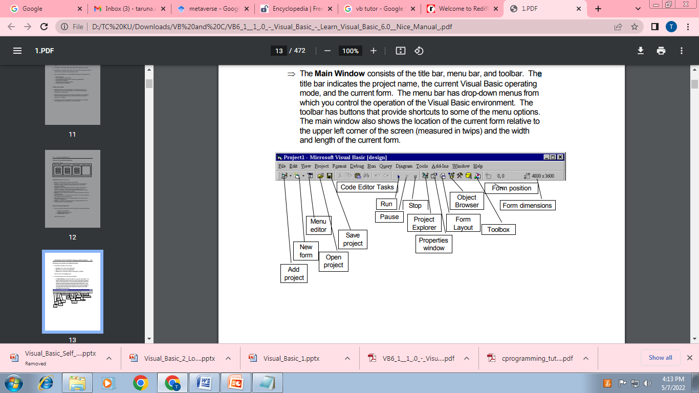

Slide 28
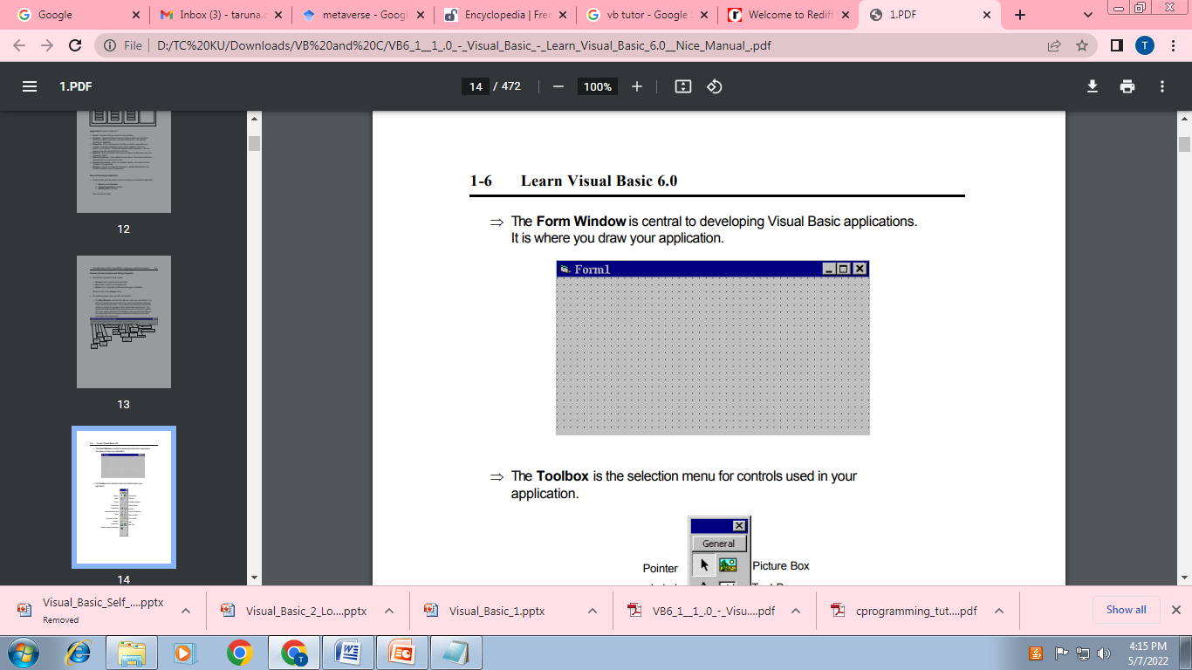

Slide 29
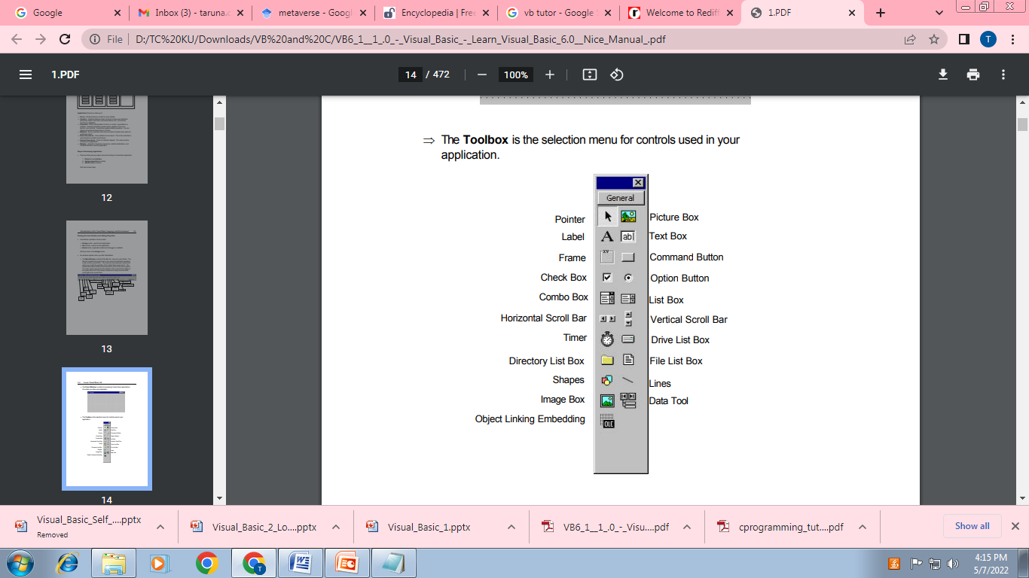

Slide 30
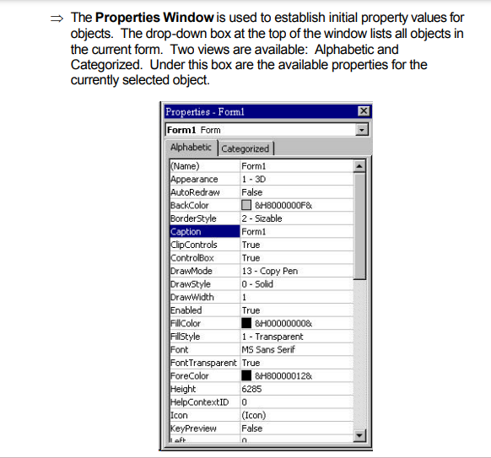

Slide 31
Thank You

